Slide 1


Platform for
SKKU Foreign Students
Team 4.75 김지수 이유진 정대교 Jose Antunes
Notes:
Hello everyone, today I will be talking our rough topic, platform for skku foreign students

Slide 2
Why Our Topic Is Important?
- 5,832 foreign students in SKKU (4th place in 2023)
- Need to help SKKU foreign students to adapt to Korea
- Absence of a platform dedicated to SKKU foreign students
Notes:
교환학생 및 전체적인 유학생 수 증가 -> 2023년 교육부 통계에 따르면 성균관대학교 외국인 유학생 수 총 5,832명으로 전국 4위
As of 2023, there are more than 5000 foreign students studying at SKKU, ranking 4th in the country. Foreign students face various challenges lack of the platforms to communicate each others. like finding house to live, constructing their timetable.. therefore, we believe there is a strong need for a platform that supports their integration and offers essential resources tailored specifically to their needs.
5,832로 전국 4위를 기록할 만큼 외국인 유학생이 많기 때문에 -> 외국인 유학생들 사이의 정보 공유, 한국에서의 적응, 교류 등에 대한 필요성 또한 대두되는데도 불구하고 -> 전용 플랫폼이 부족하다. 이런 흐름을 상정해서 정리했습니다.

Slide 3

Related Works (1) DoDream Platform
- Targeting foreign students in Korea
- Online TOPIK learning
- Contents for studying in Korea
- Bulletin board for sharing information
- Information about universities in Korea
https://play.google.com/store/apps/details?id=io.dainleaders.dodream&hl=ko
Notes:
우선 이전 페이지에서 related works로 넘어올 땐 본격적으로 구체적인 계획을 세우기에 앞서서, 관련된 사전 서비스를 검토함으로써 insight를 얻고 차별점을 고민해보려고 했다는 식으로 연결하면 좋을 것 같습니다.
Before we move forward with concrete plans for our platform, we first reviewed some existing services to gain insight and identify areas where we could offer something different and more effective for SKKU students.
there are two existing related works. DoDream is a platform aimed at foreign students across Korea. It provides a range of services, including:
Online learning for the Test of Proficiency in Korean (
본문 내용을 보자면,
한국인 유학생들을 대상으로 하는 플랫폼 두드림
그 아래 네 가지는 기본으로 제공하고 있는 기능을 적어놓은 건데 전부 다 읽어야 할 필요는 없을 것 같고 상황에 따라 선택적으로 하면 될 것 같습니다.
https://play.google.com/store/apps/details?id=io.dainleaders.dodream&hl=ko

Slide 4
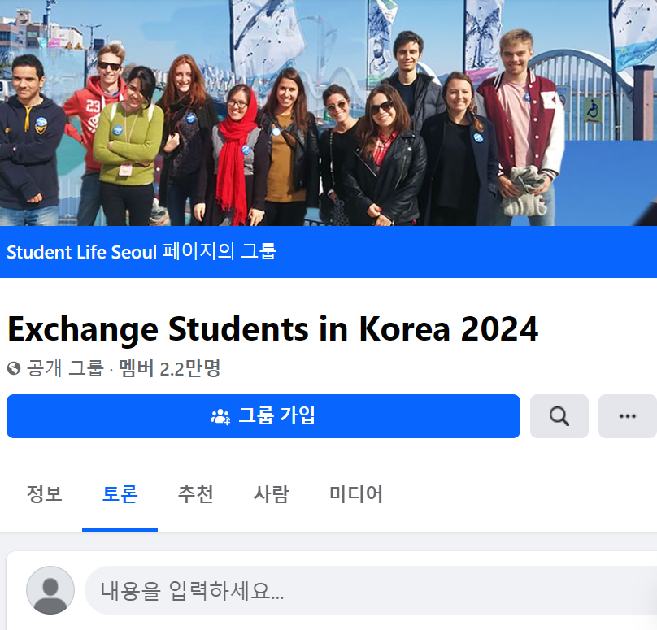
Related Works (2) Facebook Group
- Targeting exchange students in Korea
- Sharing life in Korea
- Looking for housemates
- Notification of events
- Buying and selling unused textbooks
https://www.facebook.com/groups/studentsinternsinseoul/
Notes:
There are several Facebook groups targeted at exchange students in Korea.
These groups allow students to:

Slide 5
Core Goals
Main features of existing works + SKKU-only + engagement
To be more specific,
- Basic information about SKKU (Both Seoul and Suwon)
- Networking for SKKU foreign students
- Sharing their own lives in SKKU
- Helping them adapt to Korea (Especially SKKU)
Notes:
Previous two works have good features. however…
Related work 1 -> This is not SKKU only.
Related work 2 -> This is not SKKU only. Not very activated.
So, we propose a topic about (main features of related works basically) + SKKU-only + well activated platform.
to be more specific….

Slide 6
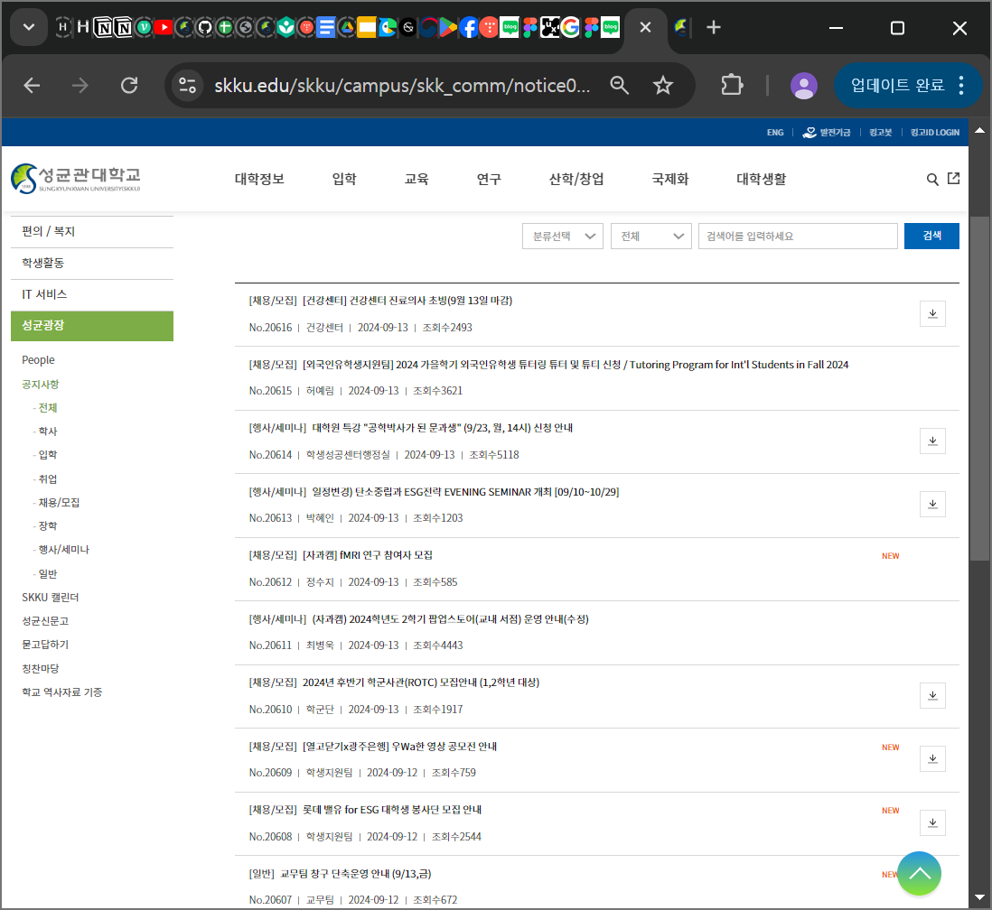
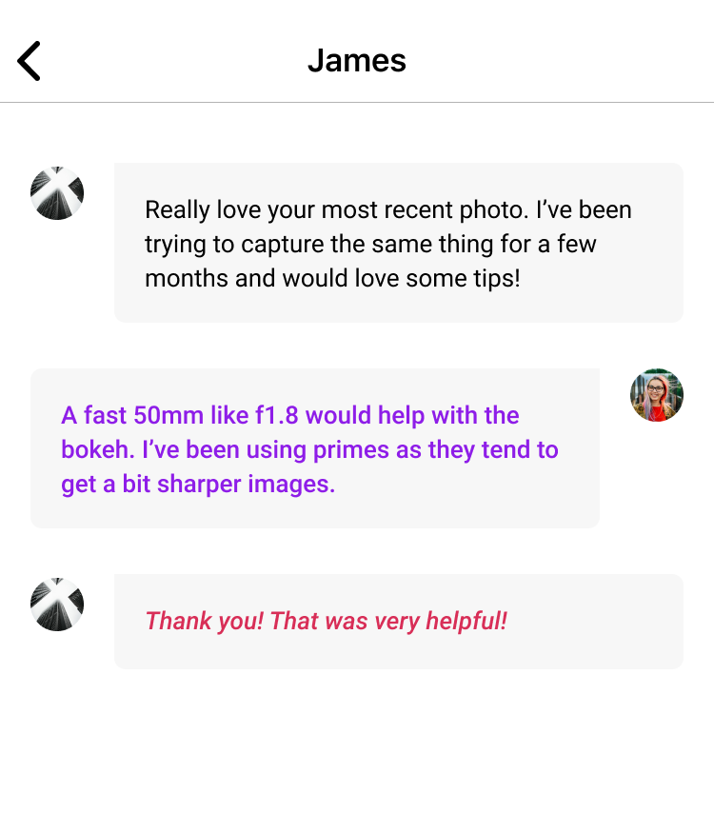
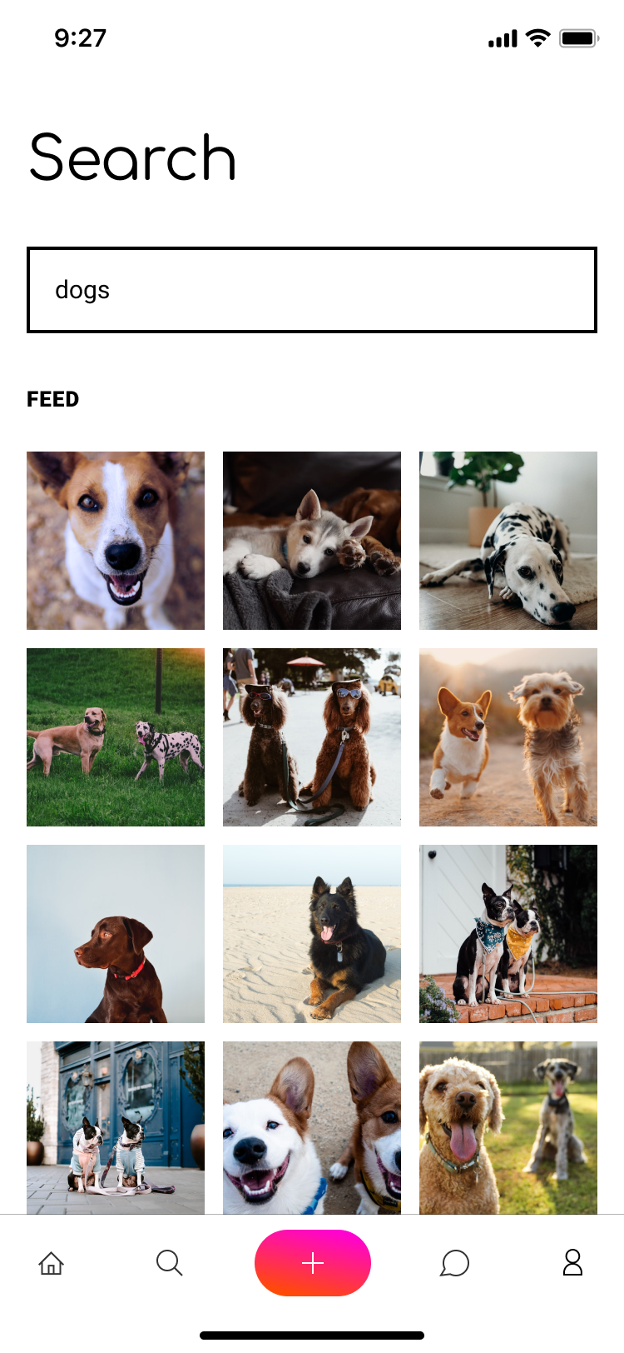

Rough Ideas
Bulletin board
Chatting
Sharing life
Moreover, Learning SKKU Culture, Timetable, …

Slide 7
Thank you for listening

